Slide 1
My Clays
Yingchao Yu

Slide 2
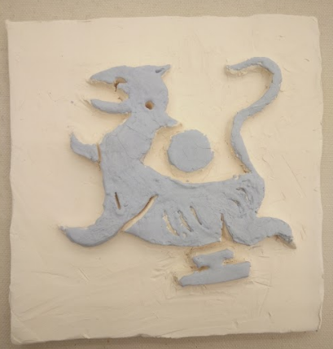
#1 Tile
1. My first artwork
After bisque

Slide 3
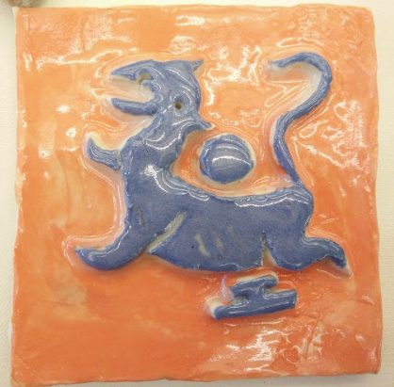
After glaze

Slide 4
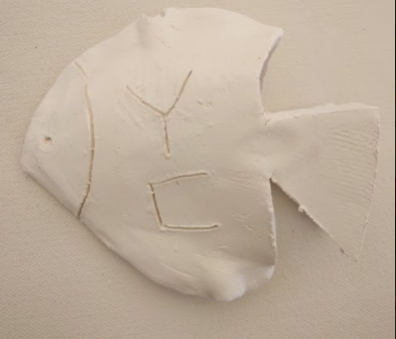
#2 Fish with Flag
1. Random thinking using chopstick to connect them together

Slide 5
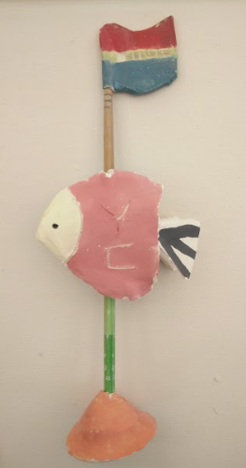
After glaze
Hole is too small

Slide 6
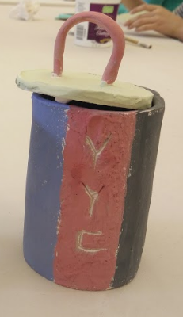
#3 box cup
1.Normal

Slide 7
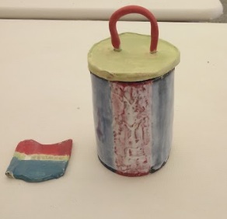
After glaze
My handle was broken for my carelessness 2 times

Slide 8
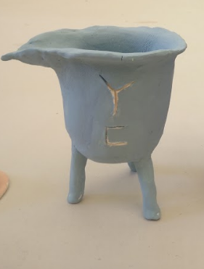
#4 Chinese cup
1. named ”Shang ”
This is the simple version of “Shang”

Slide 9

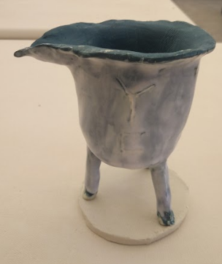
After glaze I feel disappointed
Tips: Need to put wax resist on the bottom when dipping in the glossy material.

Slide 10
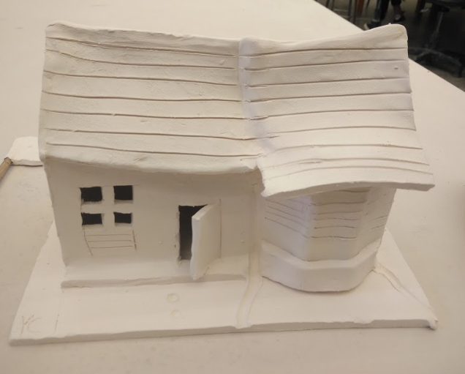
#5 Dream House
In my childhood, I drew the house most. Especially, the shape 田 is typical for me to create a window.

Slide 11
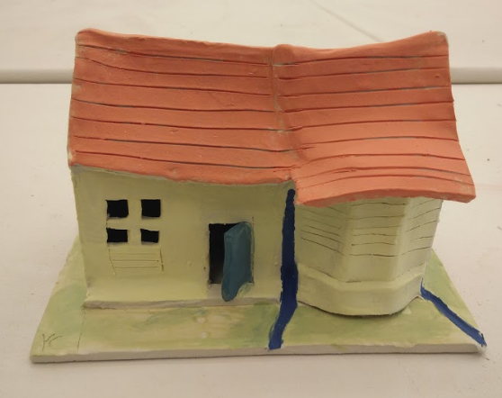
After glaze

Slide 12
My statement
In my clay artwork, I am using the idea “the things related to my life”. I want to remember what is in my life and how can I build them and present them using clay. I think the beginner should gather real things and build real things first and then after lots of practice, we can expand our imagination and build what you think is creative. That is my way to learn the ceramic course.

Slide 13
Thank you!

